Slide 1
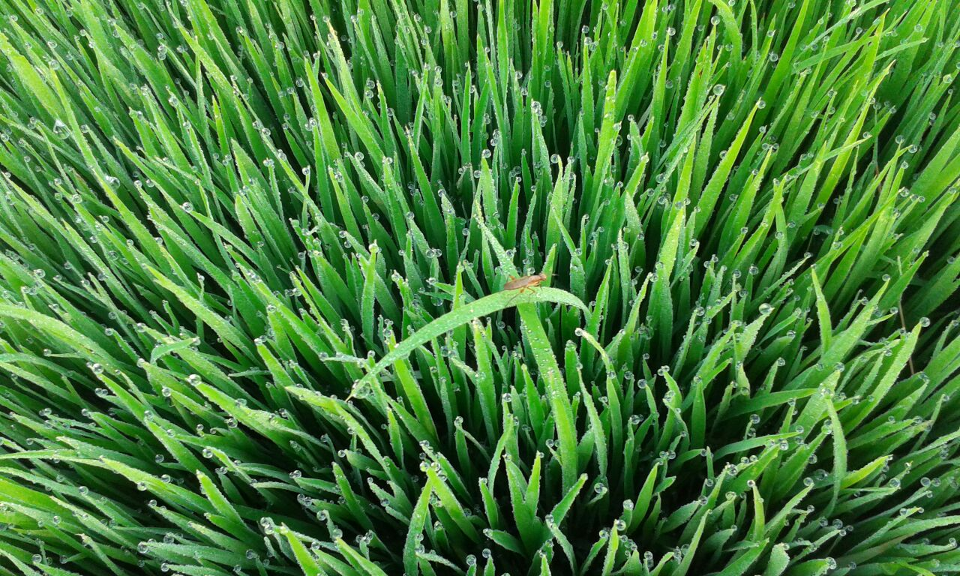
PEST CONTROL THROUGH
NATURAL ENEMIES
Resmi M.V, Agri. Officer, Krishibhavan, Vadakkenchery

Slide 2
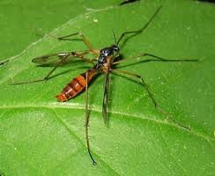
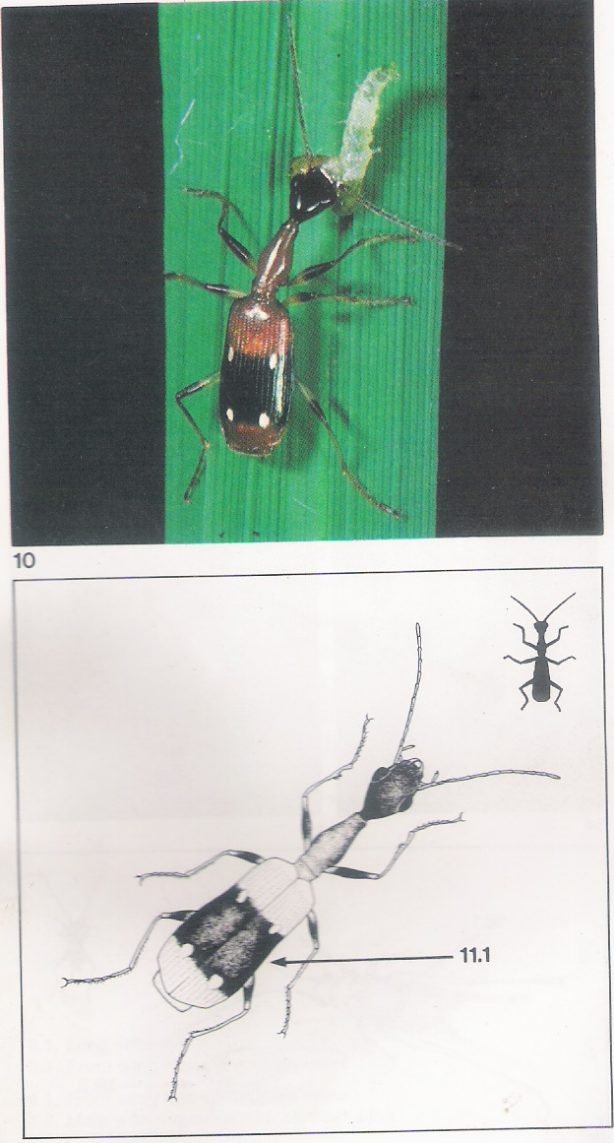
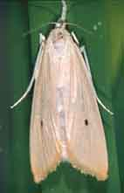
Agro Ecosystem Analysis in Rice
3 Types of insects in paddy fields
Neutrals in in paddy fields
Natural enemies in paddy fields
Insect pests in paddy fields

Slide 3
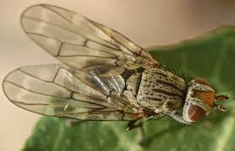
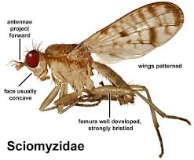
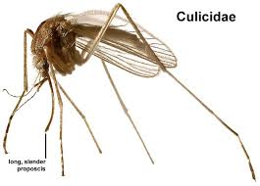
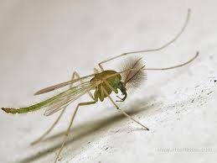
NEUTRALS IN PADDY FIELDS
Filter feeders – feeds on small plants
Detritivors – feeds on small animals
Otitidae
Chironomidae
Tanyderidae

Slide 4
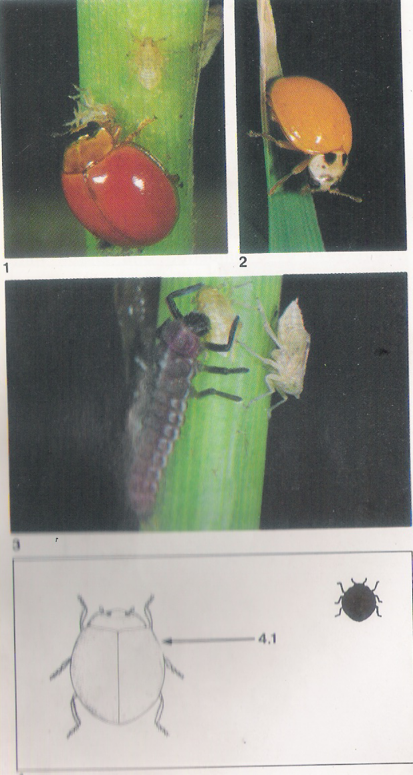
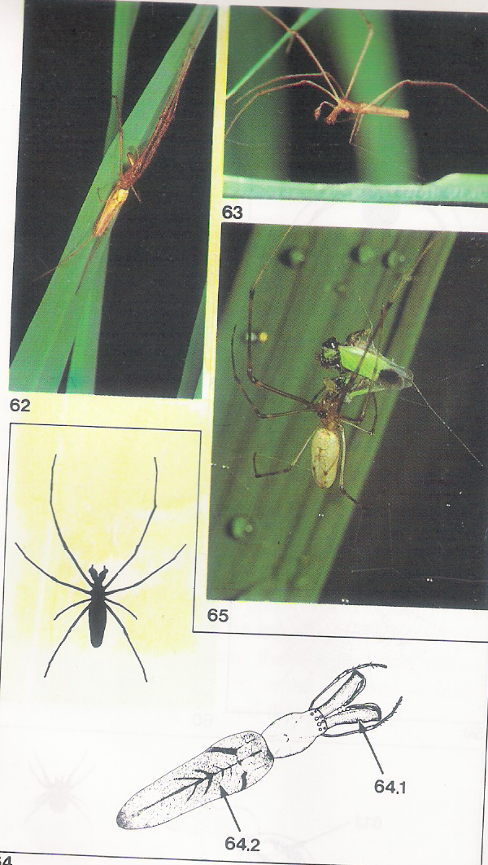
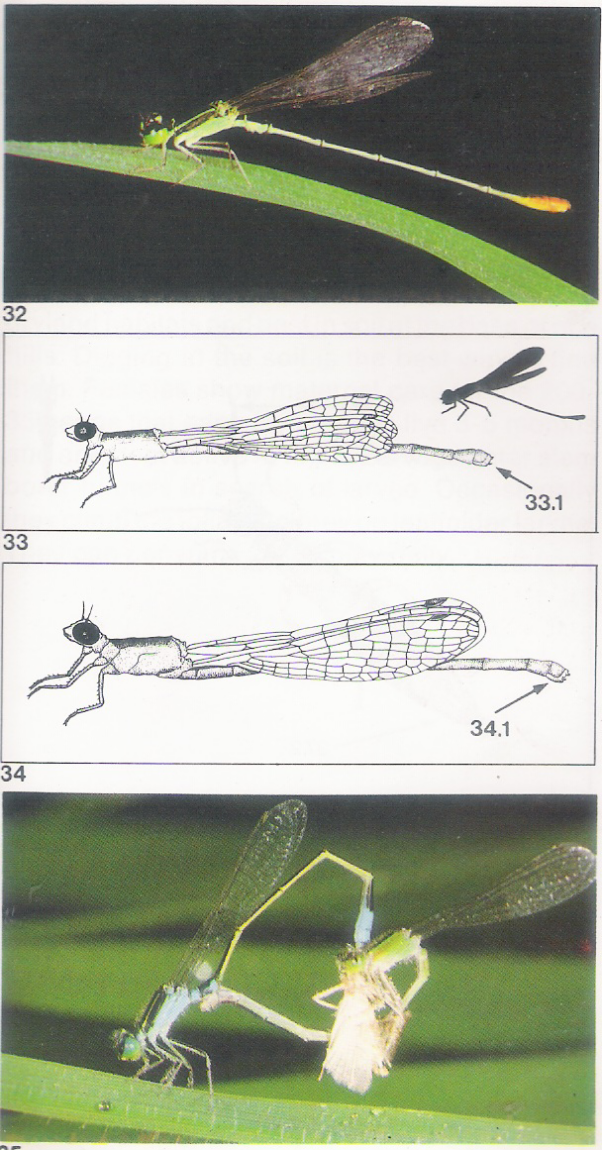
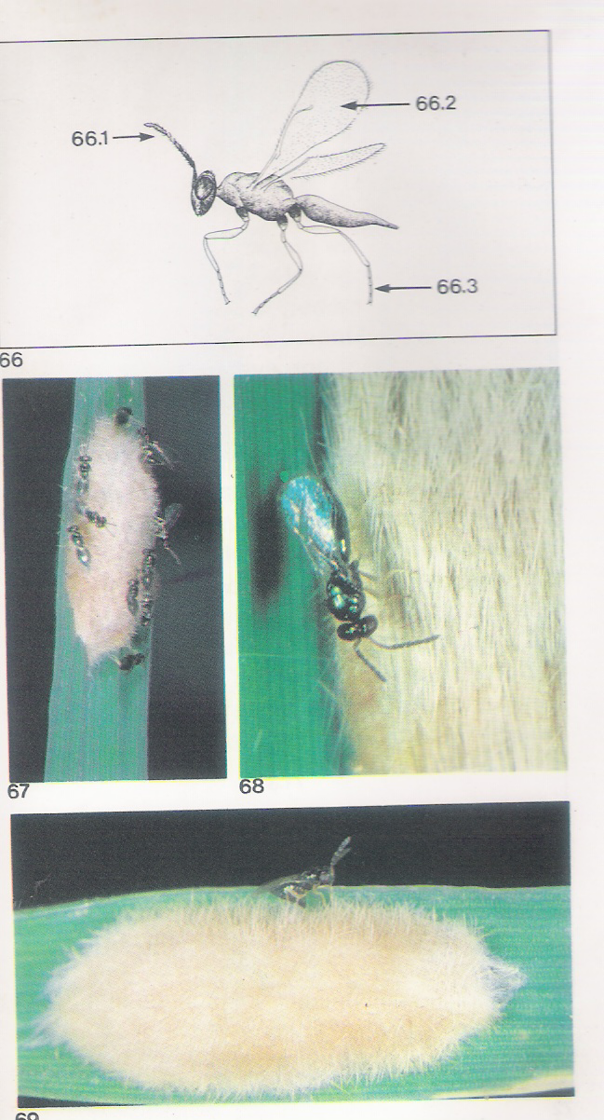
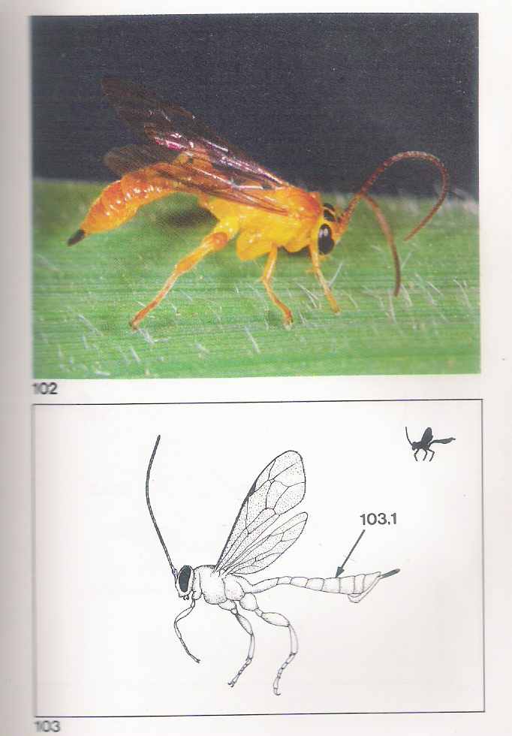
NATURAL ENEMIES IN PADDY FIELDS
Predators
Spiders
Damsel flies
Beetles
Crickets
Grass Hoppers
Bugs
Parasitoides
Egg parasitoides
Larval parasitoides
Pupal Parasitoides
Adult feeders

Slide 5
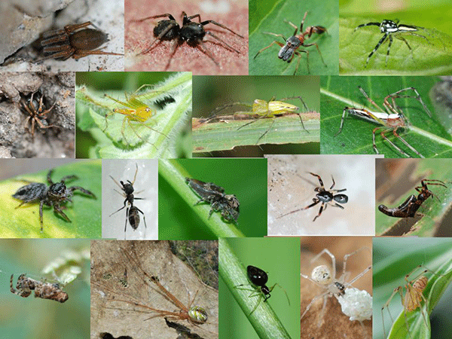
Pest control by spiders: Rice ecosystem
Spiders are the main biological control agents contributing to pest control across the season

Slide 6
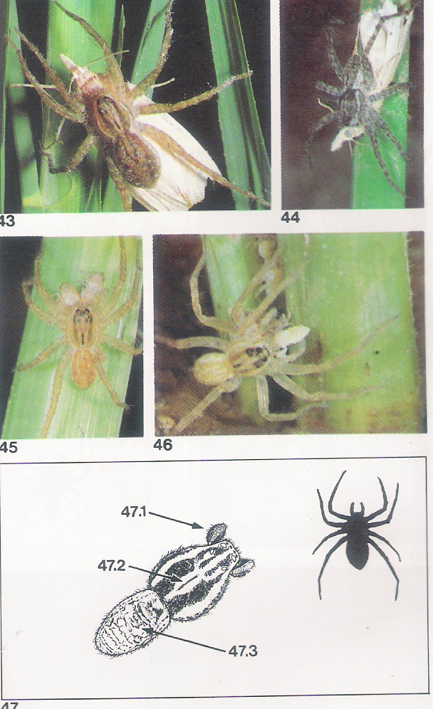
Lycosa pseudoannulata Araneae:Lycossidae
Notes:
Wolf spider.Scamber acoss water surface when disturbed.

Slide 7
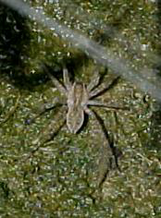
Lycosa pseudoannulata

Slide 8
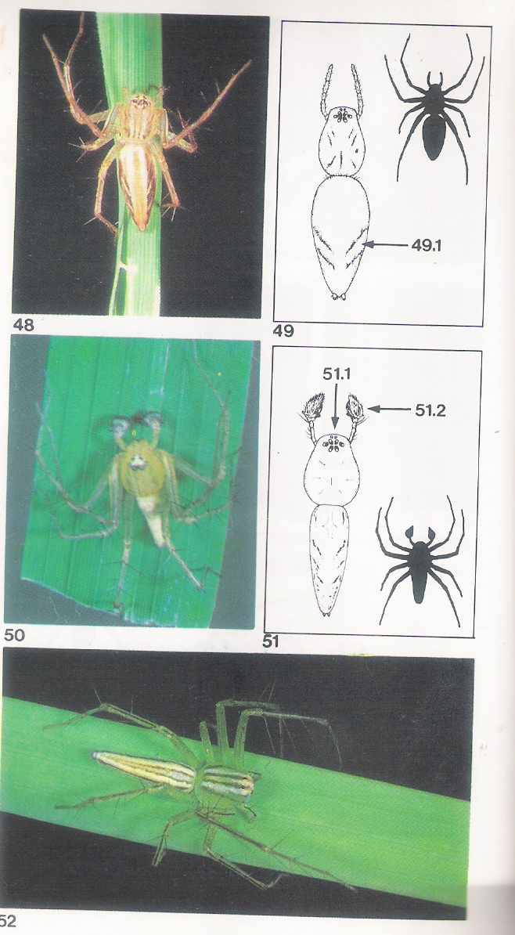
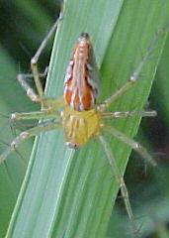
Lynx Spider- Oxyopus sp

Slide 9
Oxyopes lineatipes

Slide 10
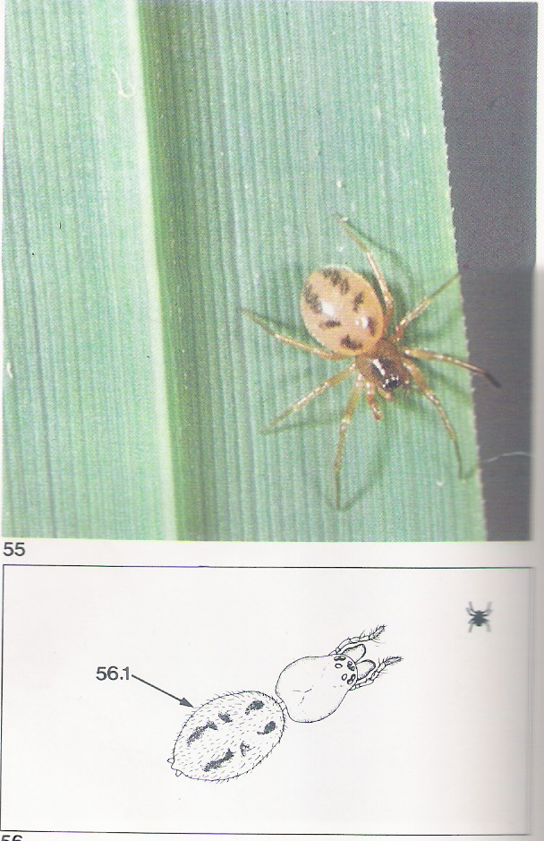
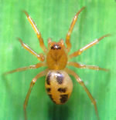
Drawf spider.Atypena formosana

Slide 11
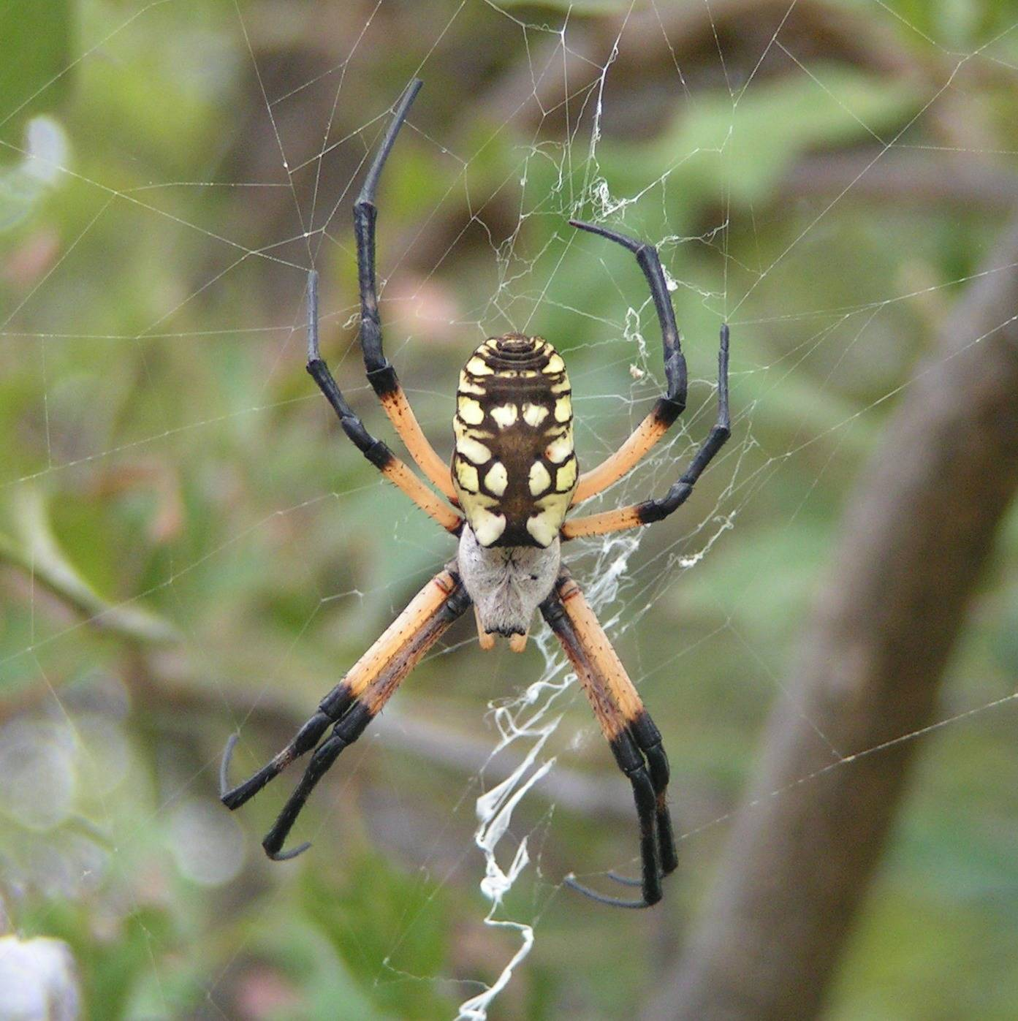
Argiope catenulata

Slide 12
Tetragnatha maxillosa

Slide 15
Micraspis crocea- Lady Bird Beetle
Micraspis sp. brightly colored in shades of red. Lady beetles are active during the day in the upper half of the rice
canopy in dryland and wetland habitats. Both the adult and the dark larva of Micraspis crocea
feed on small planthopper prey as well as on small larvae
and exposed eggs.

Slide 16
M.crocea- Dark Larvae

Slide 17
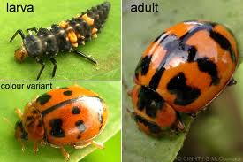
Harmonia octomacula

Slide 18
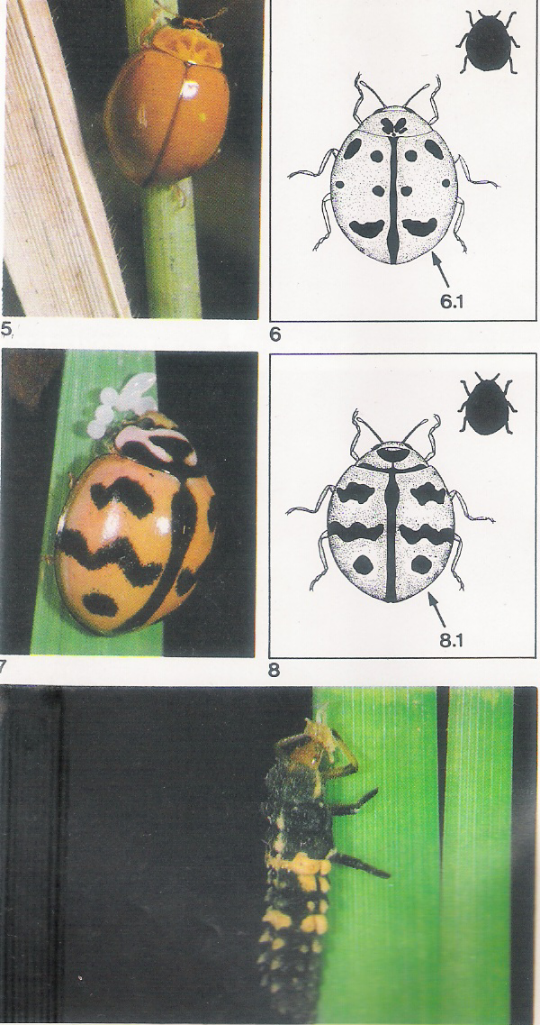
Harmonia octomaculata larva feeding on a plant hopper nymph

Slide 19
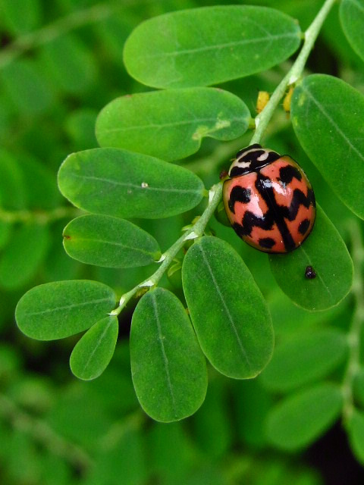
Menochilus sexmaculatus

Slide 20
Harmonia octomaculata and Menochilus sexmaculatus are black-spotted lady beetles that catch slow-moving prey. Adults are quick to fall off plants or fly when disturbed. A lady beetle takes 1-2 weeks to develop from egg to adult and produces 150-200 offspring in 6-10 weeks. Lady beetle larvae are more voracious than adults and consume 5-10 prey (eggs,nymphs, larvae, adults) daily.

Slide 21
Ophionea nigrofasciata
Ophionea nigrofasciata can be found within the folded
leaf chambers made by leaffolder larvae. The predator
larva pupates in the soil of wetland rice bunds or dryland
fields. Each voracious predator consumes 3-5 larvae per day, leaving only the head capsules. The adult also preys on planthoppers.

Slide 22
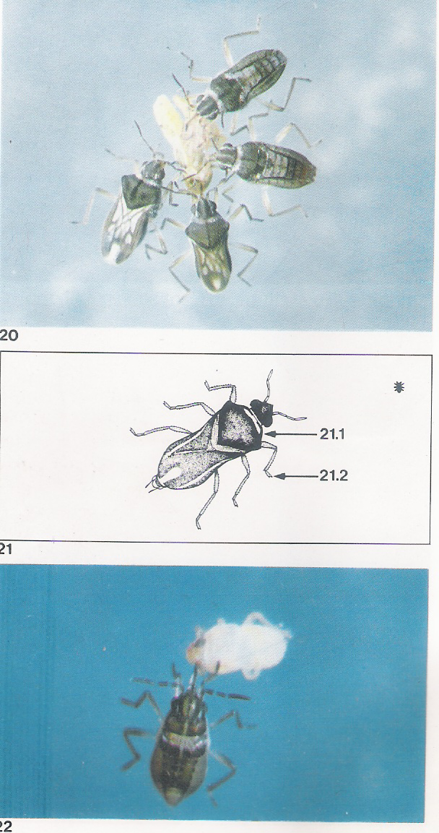
Microvelia douglasi atrolineata Bergroth.Velidae
Adults congregate to feed on planthopper nymphs
which frequently fall onto the water. The nymph also feeds on hopper nymphs as well as on other small, soft-bodied insects. Microvelia is a more successful
predator when attacking in groups and young hopper
nymphs are more readily subdued than older and larger
prey. Each Microvelia can prey on 4-7 hoppers per day.

Slide 23
Mesovelia vittigera (Horvath) Mesovelidae
Mesovelia adults
and nymphs feed mainly on stem borer larvae and hoppers that fall on the water surface. They are solitary Feeders.

Slide 24
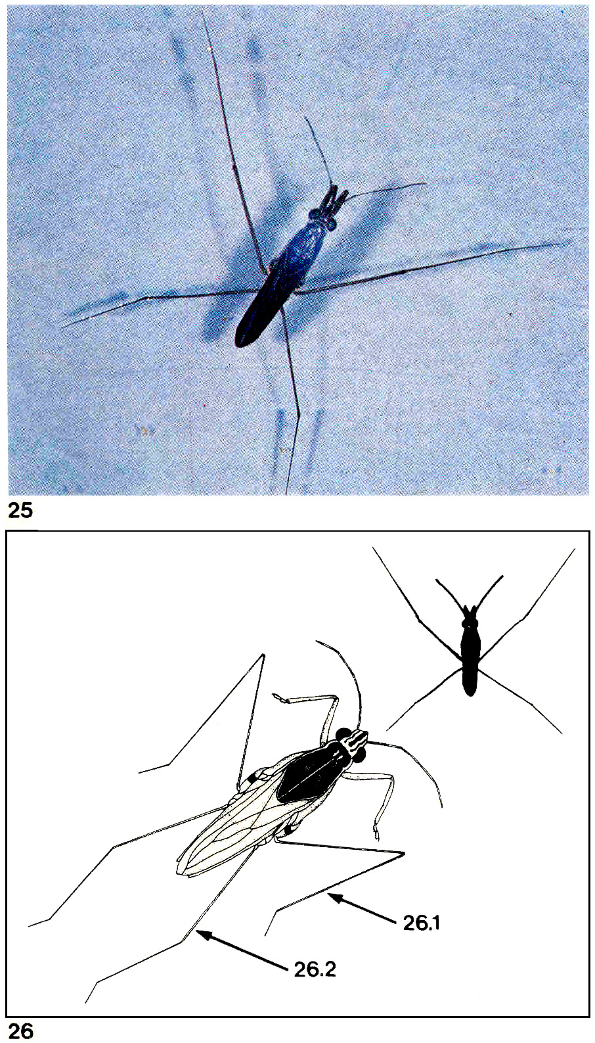
Water Striders Limnogonus fossarum
Limnogonus live for 1-1.5 months and lay 10-30 eggs in rice stem above the water line.
Adults and nymphs prey on rice hoppers, moths, and larvae that drop onto water surface. Each water strider takes 5-10 prey daily.

Slide 25
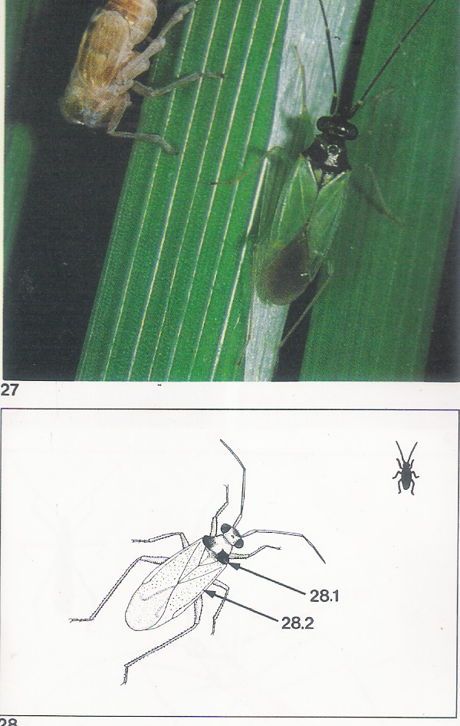
Cyrtorhinus lividipennis Reuter Miridae
Cyrtorhinus is an example of a species belonging to a
plant-feeding group that secondarily became predators, preferring planthopper and leafhopper eggs and young nymphs. The green and black adults and nymphs can become highly abundant in hopper-infested
fields, both wetland and dryland. Cyrtorhinus eggs are laid in plant tissue, develop to adults in 2-3 weeks, and produce 10-20 young. They search leaf sheaths and
stems for hopper eggs, which are sucked dry by piercing mouthparts. Each predator consumes 7-10 eggs or 1-5 hoppers a day.

Slide 26
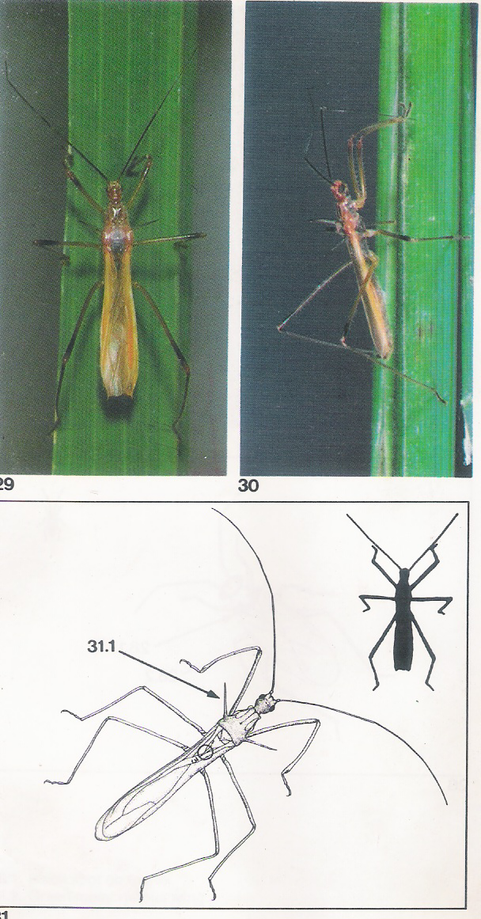
Polytoxus fuscovittatus(Stal) Reduviidae
Assassin bugs as solitary predators rarely become abundant in either the wetlands or drylands. Assassin bugs occur in the rice canopy in search of prey, mainly larvae of moths and butterflies. They attack a prey even much larger than themselves, piercing its body with their needle-like mouthparts to inject a paralyzing toxin.

Slide 27
Agriocnemes pygmoea
The male hooks onto the
back of the female so they can fly while mating to escape their enemies. Damselfly nymphs are aquatic and can
climb up rice stems to search for hopper nymphs. Adults normally fly below the rice canopy searching for flying insects as well as hoppers on plants.
Notes:
Male

Slide 28
A.Femina femina
Notes:
Mating pair

Slide 29
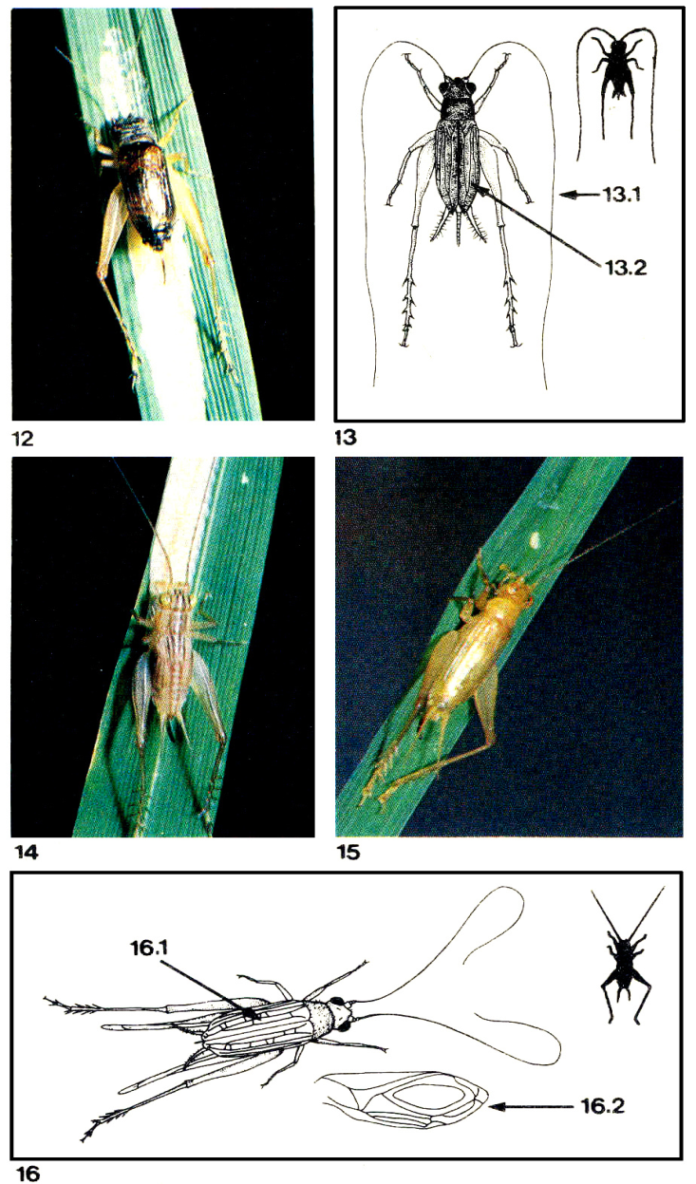
Crickets- Metioche vittaticollis
Adults and nymphs are
primarily egg predators but will also feed on small larvae
and hoppers. They feed on eggs of striped and dark headed stem borers, leaffolders, armyworms, whorl
maggots, and nymphs of planthoppers and leafhoppers

Slide 30
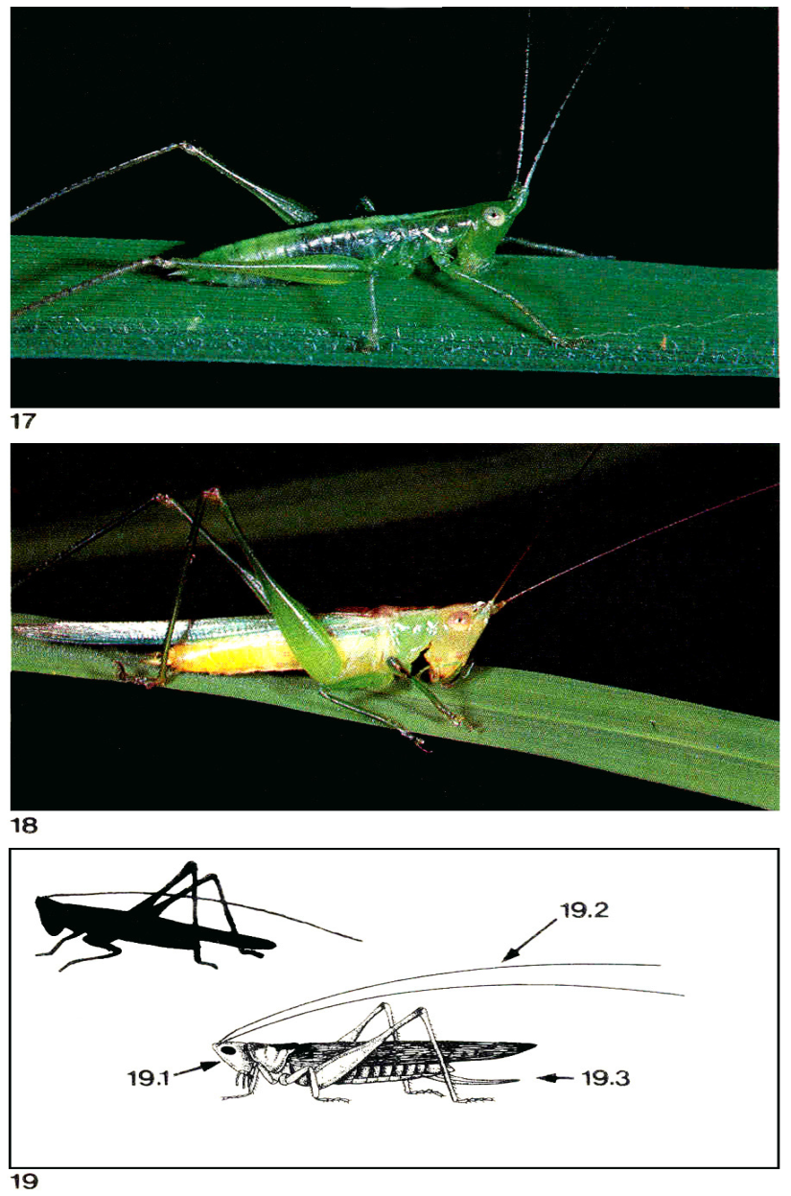
Predator Grass Hopper Conocephalus longipennis
Tettigoniids feed on rice foliage and Conocephalus
longipennis has dual food habits. Aside from feeding on
rice leaves and panicles, Conocephalus is also a predator
of rice bug and stem borer eggs as well as planthopper
and leafhopper nymphs. Each predator can consume 3-
4 yellow stem borer egg masses a day.

Slide 31
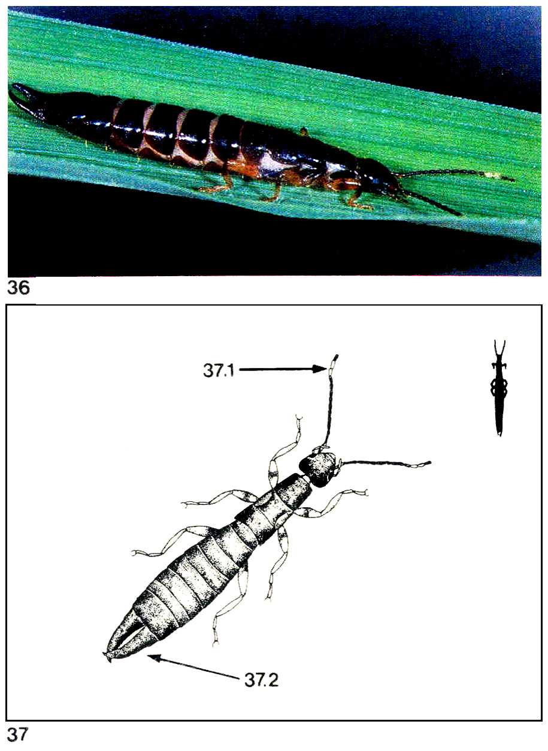
Predator — earwig Euborellia stali
Adults live 3-5 months and are most active at night. Earwigs enter stem borer tunnels in search of larvae. Occasionally they climb the foliage to prey on leaffolder larvae. They can consume 20-30 prey daily.

Slide 32
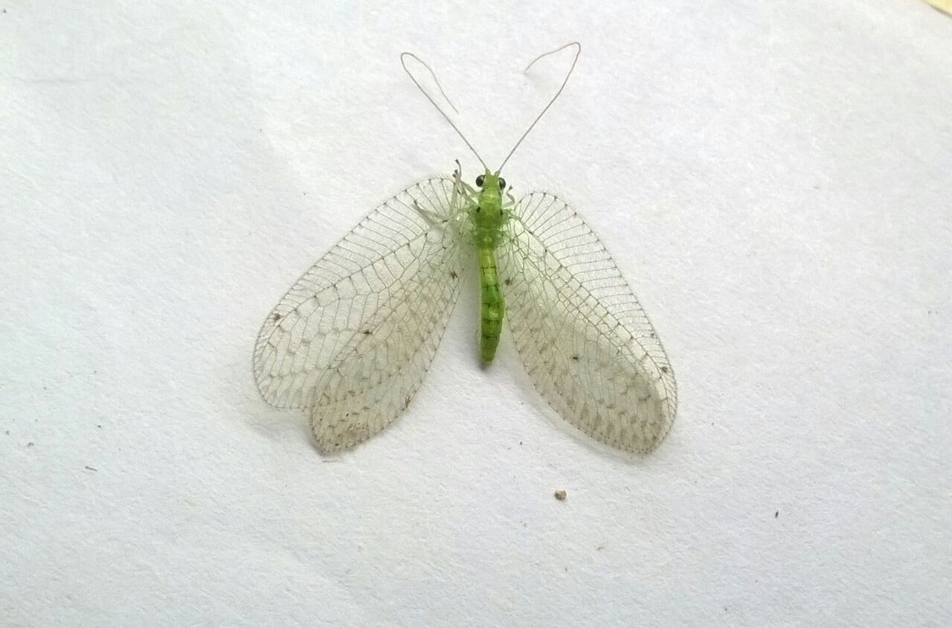
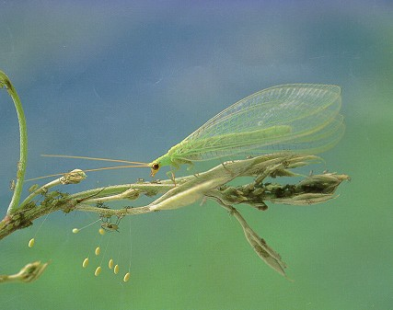
Green Lace Wing Chrysoperla sp

Slide 33
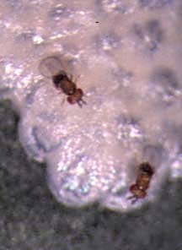
Egg parasite of Stem Borer
Trichogramma japonicum

Slide 34
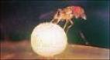
Trichogramma chilonis
Eggparasite of leaf folder

Slide 35
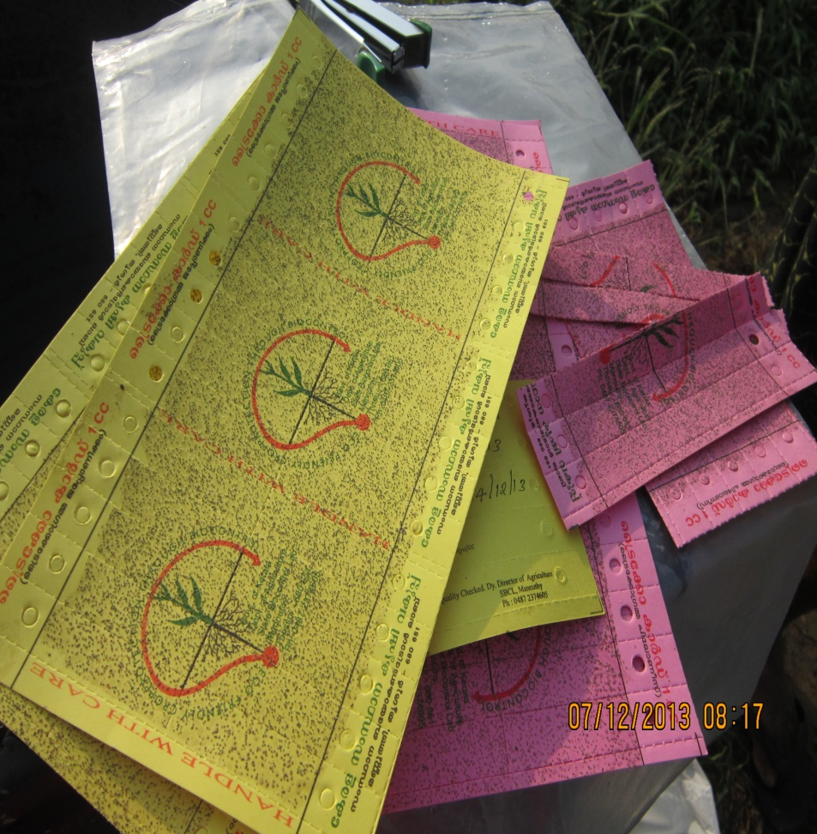
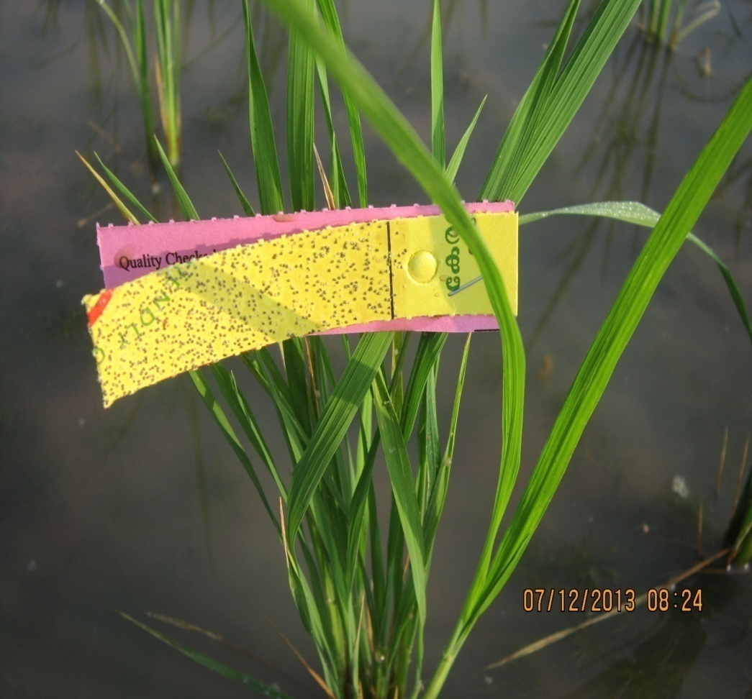
Egg card
Trichogramma chilonis for leaf folder
Trichogramma japonicum for Stem borer

Slide 36
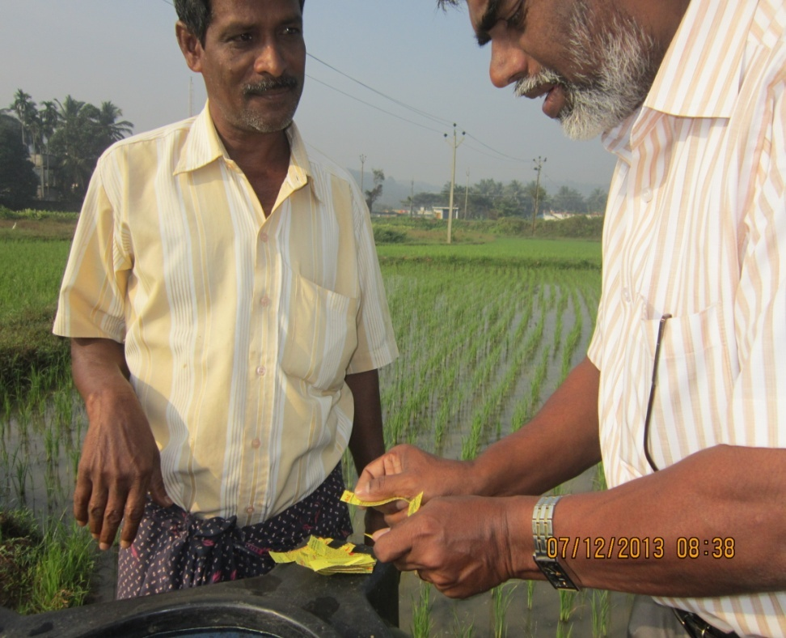
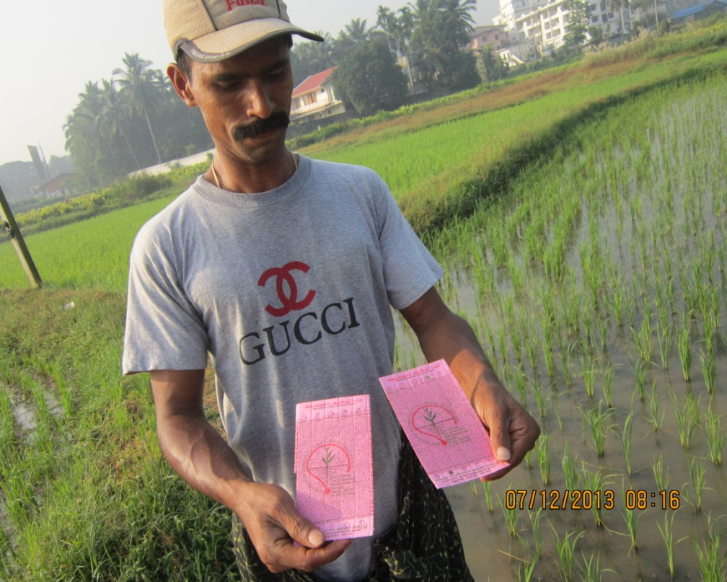
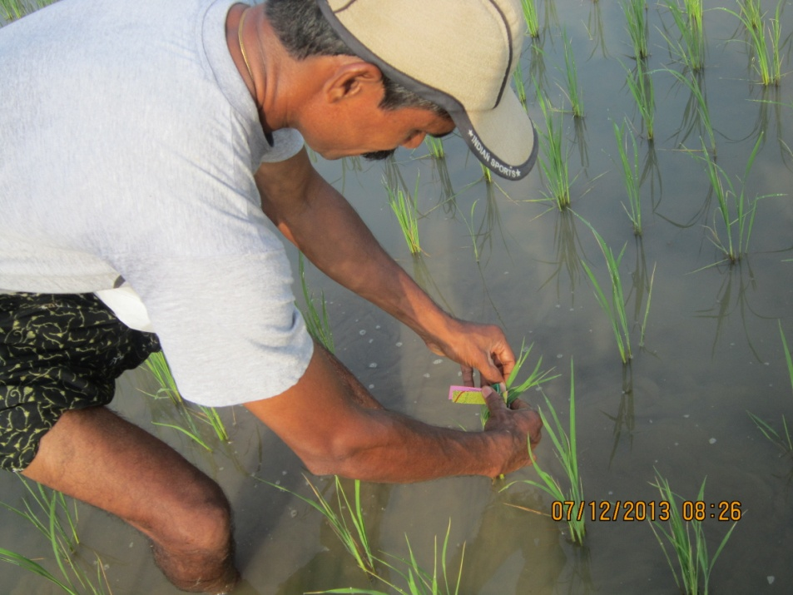
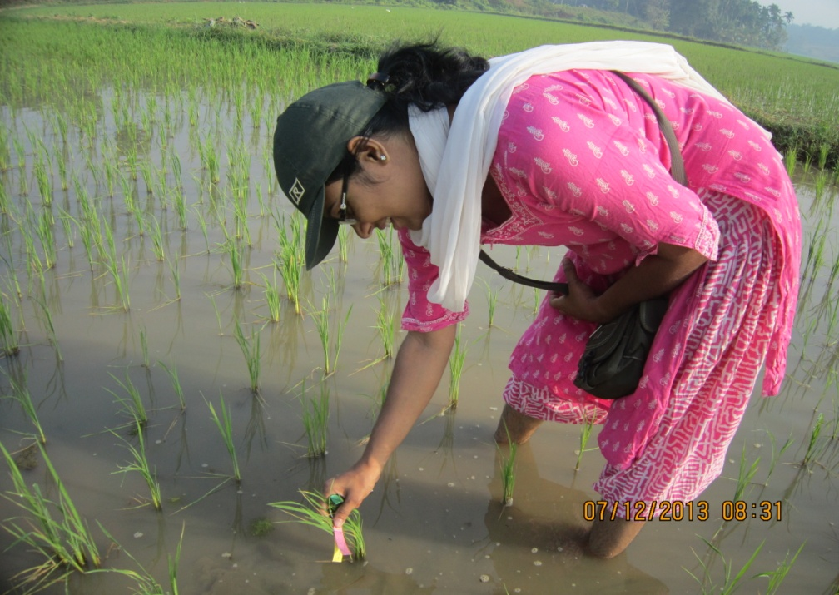

Slide 37
Tetrastichus schoenobii Eulophidae

Slide 39
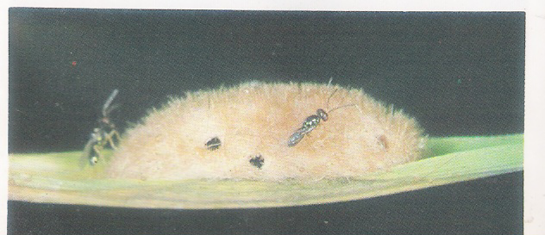
Telenomus rowani(Gahan) Scelionidae
Tetrastichus and Telenomus may parazitize the same egg mass but
Not the same egg

Slide 40
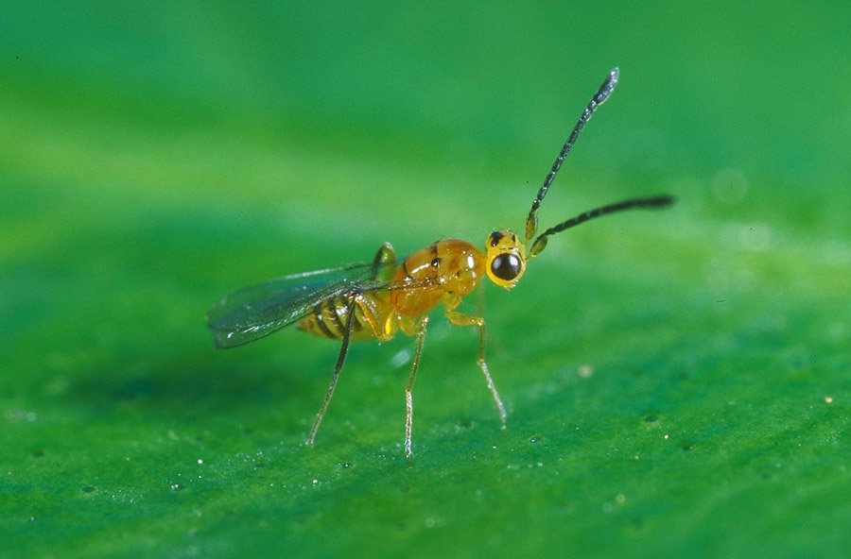
Gontocerus spp.Mymaridae
Female can reproduce without mating.Parasitise the eggs of leaf hoppers and plant hoppers.

Slide 41
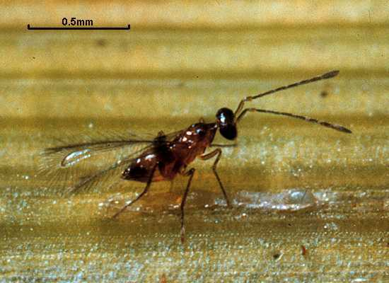
Anagrus optabilis(Perekins) Mymaridae
Female can reproduce without mating.Egg parasite of leaf hoppers and plant hoppers.Parasitized eggs turn deep orange red and nomal eggs are white.

Slide 42
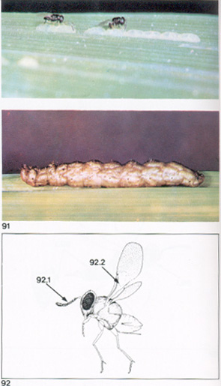
Barely visible to the naked eye. Parasite larva develop inside host larva even after host larva hatch. The wasp egg divide many times and hundreds of wasp pupae can be seen through skin of LR larva.
Copidosomopsis nacoleiae
Encyrtidae

Slide 43
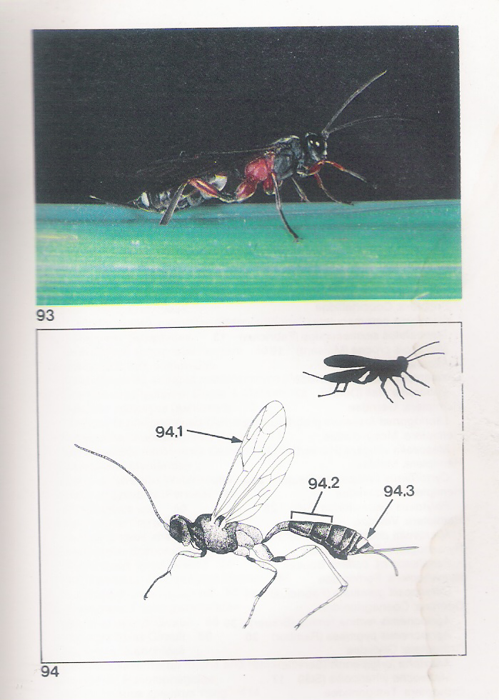
Amauromorpha accepta Ichneumonidae. Specialises in yellow and white stem borers.Single egg is laid in larval host.Emerges from dead host and pupates in larval tunnel.

Slide 44
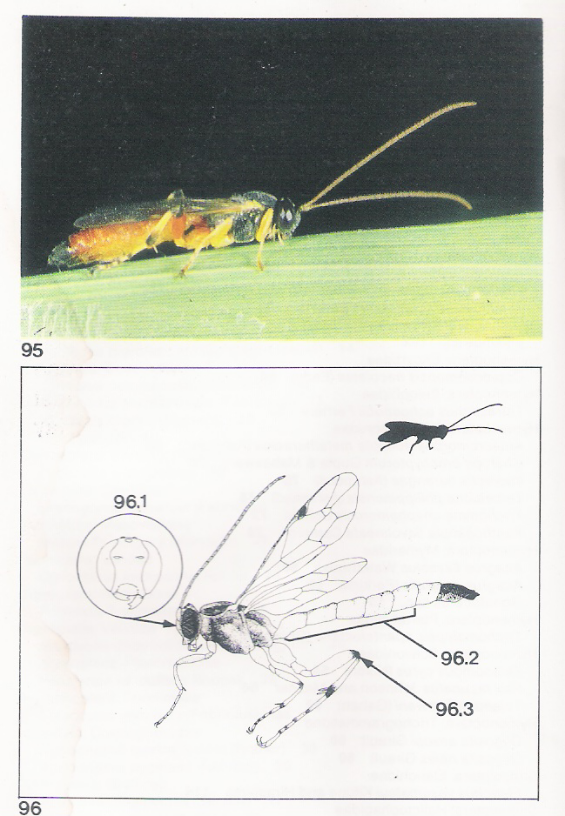
Itoplectis narangae
Parasitises larvae of leaf folder,green semilooper,hairy caterpillar and striped and pink stem borers.

Slide 45
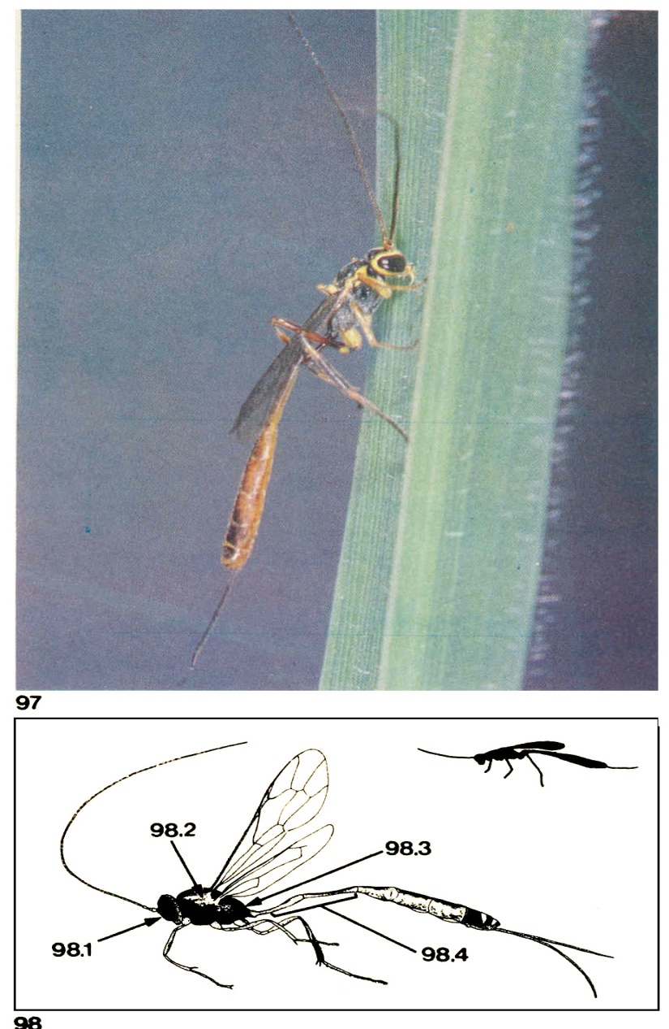
Trichomma cnaphalocrosis Ichneumonidae
Older leaf folder larvae preferred.Lays single egg in leaf folder larva encountered. Pupates with in its host.

Slide 46
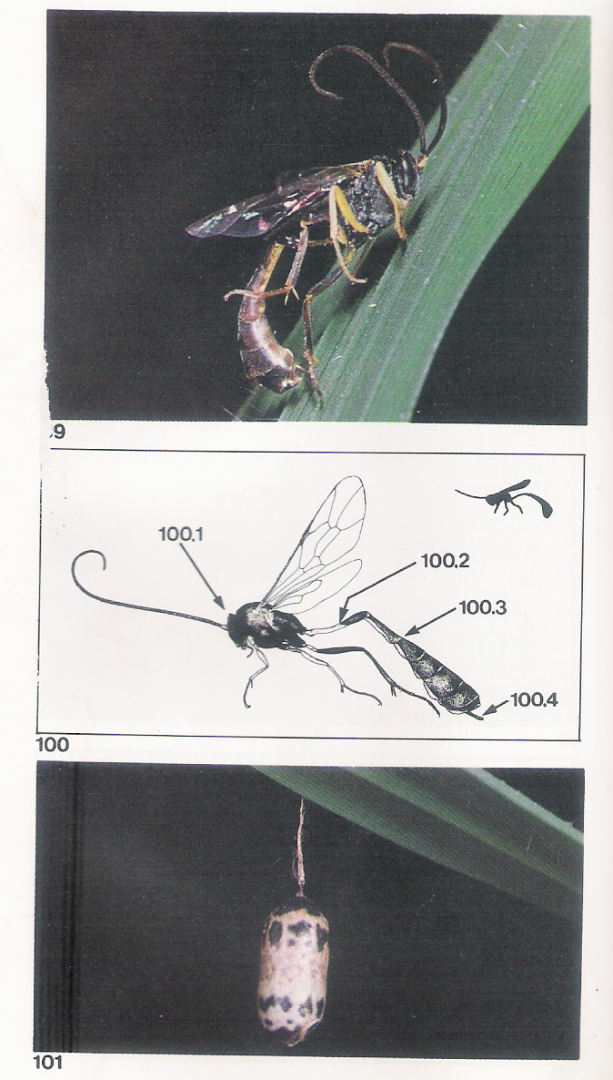
charops brachypterum
Ichneumonidae.Searches larvae of leaf folders,green semiloopers and yellow stem borers.

Slide 48
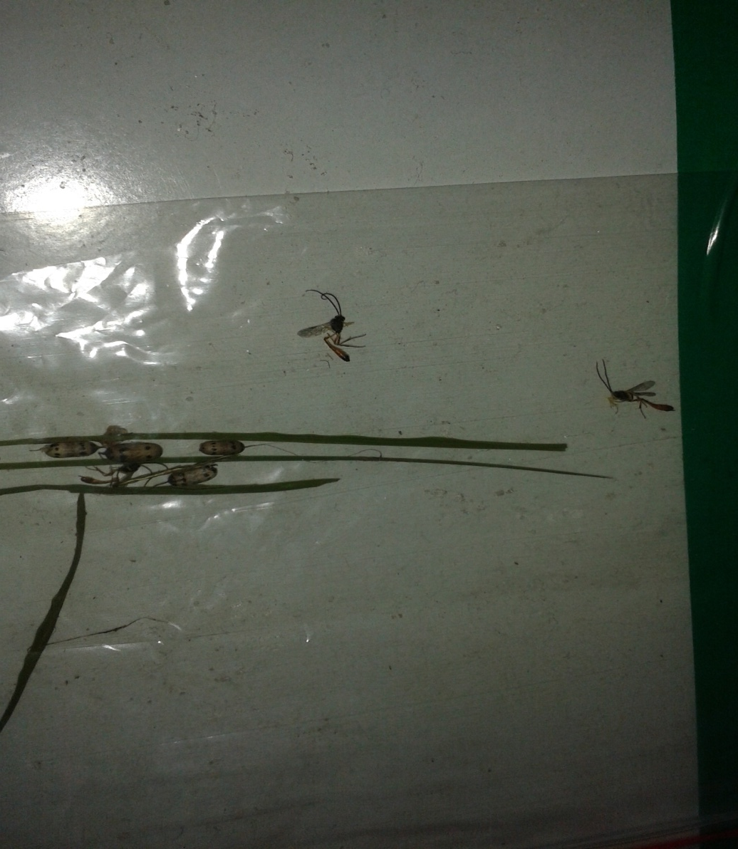

Larval parasitiodes in Paddy Charops Brachypterum

Slide 49
Xanthopimpla flavolineata
Ichneumonidae.Parasitise stemborer larva one wasp emerges from stemborer pupa with in the stem.

Slide 50

Stenobracon nicevillei(Bingham) Braconidae
Common in drylands .Seach for larva of yellow and Pink stem borer.Deposit single egg in to STB larva.

Slide 51

Temelucha philippinensis Hymenoptera: lchneumonidae
Temelucha is medium-sized and is a fast flier. During the day, they hunt stem borer or leaffolder larval hosts. When stem borer larvae move from one tiller to another they are parasitized before they can rebore into the rice stem. Upon maturity, the parasite larva leaves its host and spins a light brown cocoon in the stem borer tunnel or folded leaf. The adult wasps live 7-9 days.

Slide 52

Cardiochiles philippinensis Braconidae.
Lays single egg on leaf folder larva.The creamy white wasp larva feeds externally on host larva

Slide 53

Macrocentrus philippinensis Braconidae
Single egg is laid in a leaf folder larva.Spins a white cocoon with in leaf fold.

Slide 54

Cotesia angustibasis.Braconidae

Slide 55


Parasitoids identified during surveillance in paddy
Larval parasitiod Cotesia attacking on leaf folder larva

Slide 57
C.Angustibasis specialises as larval parasite of LF .

Slide 58

Opius sp. Braconidae.
Parasitse whorl maggot larva.One parasite larva develops in each larval host.Wasp emerges from whorl maggot pupa.

Slide 59

Goniozus nr. Triangulifer Keiffer. Bethylidae
Ant-like wasps.Parasite enters folded leaf and paralizes leaf folder larva and then lays 3to 8 eggs outside host larval body,

Slide 60

Elasmus sp. Elasmidae.
Parasitises leaf folder larva. Adult emerges either from the larva or pupa. Elasmus larva will kill other parasite larva developing inside the host larva.

Slide 61

Haplogonatopus apicalis.Pseudogonatopus nudus.
Haplogonatopus attack leaf hoppers and pseudogonatopus plant hoppers.

Slide 62

Pseudogonatopus flavifemur. Dryinidae.
One to two eggs are laid singly inside the
hopper host. In 1-2 days, the eggs hatch and the larvae feed on the body fluids. As they grow, the parasite larvae, each covered with a black to grayish sac, protrude from the abdomen of their hosts . In 7-1 0 days, the sac splits and the whitish larva wiggles free.
The larva then pupates and secretes a whitish oval silk cocoon to cover the pupa on the plant . The flat cocoon turns reddish brown when the wasp is ready to emerge.

Slide 63

Brachymeria sp
The parasitize older larvae of leaffolders, skippers, and satyrids. A single egg is deposited in the body of each larval or pupal host and pupation occurs inside the host. Adult wasps emerge from the head portion of the pupa and live 3-5 days.

Slide 64

Argyrophylax nigrotibialis Tachinidae
Parasitises the skipper larva. The puparia near the dead skipper larva are covered with white powder.

Slide 65

Pipunculus/Tornosveriella sp
Big-headed flies alight on the back of leafhoppers
and oviposit into the host’s abdomen. A single fly
develops from each leafhopper. After developing inside its host, it pupates in the soil or at the base of the
plant. The egg develops into an adult in 30-40 days.
Flies live 4 days and parasitize 2-3 hoppers per day.

Slide 66

Metarhizium.Moniliales:Moniliaceae
Fungi infect hoppers,bugs and beetles.Spores germinate to grow in to insect body,consume body contents.When the insect dies the fungus emerges first as white growth from the host bodyjoints.When spores are formed the fungus turns dark green if it isM.anisopliae or light green if it is M.flavoviridae.Spores emerging from dead host are spread to new hosts by wind and water.

Slide 67
M.anisopliae

Slide 68
M.flavoviridae

Slide 69

Beauveria bassiana.Moniliales:Moniliaceae
White fungus attacks plant hoppers,leaf hoppers,stem borers,leaf folders,rice bugs and black bugs.Invades soft tissues and body fluids and grows out of the body to produce dispersing spores.Spores appear chalky white as on fhe body of BPH.

Slide 70
B.bassiana
Chalky white spores

Slide 71

Hirsutella citriformis.Moniliales:Stilbaceae
Infects plant hoppers and leaf hoppers.The fungus grows out of the body of the host as long filaments.The dispersing infectious spores are produced from the filaments.

Slide 73

Nomuraea releyi.Moniliaceae
Attacks larvae of stem borers,leaf folders,green hairy caterpillars,armyworms and caseworms.Early in the infective stages the larvae become white.After few days spores are formed and the caterpillars become pale green

Slide 74

Nuclear polyhedrosis viruses.Baculovirus:Baculoviridae
The cut worm becomes infected by eating virus contaminated foliage.Host larva becomes sluggish and stops feeding..Larva turns whitish and then black and hangs from the rice foliage by its prolegs.oozing fluid contaminates nearby foliage and continues disease cycle.

Slide 75
Granulosus virus.Baculovirus:Baculoviridae
Viruses attack moth and butterfly larvae.Host larva eats contaminated foliage slows movement and stops feeding.After 1to2 weeks the body becomes constricted giving segmented appearance as in the larva of semilooper.Infected larvae turn yellow,pink and black.

Slide 76

PESTS IN PADDY FIELDS
Leaf folder in Rice
Stem Borer in Rice
Gall midge in Rice
Thrips in Rice
Case worm in Rice
Blue beetle in Rice
Skipper in Rice

Slide 77





STEM BORER
Total life cycle: 6 weeks
Egg laying capacity – 150 nos.

Slide 78




YELLOW STEM BORER IN RICE

Slide 79


YELLOW STEM BORER ATTACK IN RICE

Slide 80


DEAD HEART DUE TO STEMBORER

Slide 81




Stem Borer attack in paddy
Early Tillering stage
Mid tillering stage
Dead heart
White ear heads

Slide 82








LEAF FOLDER
Total life cycle: 5 weeks
Egg laying capacity – 118 nos.

Slide 83




LEAF FOLDER IN RICE

Slide 84


LEAF ROLLER ATTACK IN PADDY

Slide 85

SKIPPER ATTACK IN PADDY
Pelopida Mathias: Rice Skipper

Slide 86



HAIRY CATERPILLAR IN PADDY
Hairy caterpillar: Psalis pennatula

Slide 87




CASE WORM
Total life cycle: 5 weeks
Egg laying capacity – 165 nos.

Slide 88






BROWN PLANT HOPPER
Total life cycle: 3 weeks
Egg laying capacity – 390 nos.

Slide 89



RICE GALL MIDGE
Total life cycle: 3 weeks
Egg laying capacity – 200 nos.

Slide 90



BLUE BEETLE IN PADDY

Slide 91



RICE BUG
Total life cycle: 3 weeks
Egg laying capacity – 20 nos.

Slide 92

Green leaf Hopper

Slide 93


Slide 94

Climbing Cut Worm

Slide 95


Slide 96

Black Bug

Slide 97


Slide 98


Slide 99


Slide 100


Slide 101


Slide 102

Pathogenic infections detected from the field

Slide 103

Pathogenic infections detected from the field

Slide 104

Pathogenic infections detected from the field – Hirsutella

Slide 105




Beauveria infected BPH obtained from the field

Slide 106


Beauveria infected rice bugs

Slide 107
PADDY ECOSYSTEM
1st 20 days – More neutrals and natural enemies than pests of paddy
20 days to 45 days – More natural enemies than pests of paddy
45 days to 75 days – more pests than natural enemies
75 days to 90 days – less pests and less natural enemies

Slide 108
PADDY ECOSYSTEM
Flooded conditions – more neutrals and natural enemies which feeds on neutrals
Planting at the time of more natural enemies
More tillers and growth – more pests- which are attacked by natural enemies in egg, larval, pupal or adult stage.
Predators feeds around 15 eggs per day.
Parasitoides destroyes 50% of eggs or eggmasses
The balance will be fed by predators in larval or adult stage.

Slide 109

Predator gets an opportunity to develop well in advance of normal pest population
Treated and un treated

Slide 110
Treated with pesticides and untreated
Untreated-Rise in neutral peak at 30 days. Subsequent rise of predator populations.Predator population build up on neutrals.pest populations have little chance to develop late in the season.
Treated-Leads to suppression of early season predator populations. subsequent resurgence of pest populations-Pesticide induced pest resurgence.

Slide 111

Trophic-level of energy flow
irrigated rice
Notes:
Irrigated rice

Slide 112
Rice has three separate pathways for energy supporting natural enemies
NATURAL ENEMIES
HERBIVORES
FILTER-FEEDERS
DETRITIVORES
MICRO-ORGANISM CYCLE
RICE PLANT
Sunlight
ORGANIC MATTER

Slide 113
Functional group relationships among the major elements in the rice community
HERBIVORES
HYPER PARASITOIDS
PREDATORS
PARASITOIDS
FILTER-FEEDERS (Adult Chironomidae, Culicidae)
DETRITIVORES (Adult Diptera, Coleoptera)
RICE PLANT
DETRITIVORES (Surface- Dwelling Collembola)
FILTER FEEDERS (Larvae)
AQUATIC PREDATORS
DETRITIVORES (Aquatic Larvae)
ZOOPLANKTON
BACTERIA
ORGANIC RESIDUE

Slide 114

THANK YOU.....

